Slide 1
What is sin?
Robert Melashenko MD

Slide 2
The word of nature declares אֵל (God) to us, the word of Scripture יהוה (Jahve); the former God's power and glory, the latter also His counsel and will.
Keil & Delitzsch

Slide 3
Thou shalt have no other gods before me.
(Exo 20:3)
“The first thing necessary in order to understand the commandment, and to know whom to obey is to know who God is, and what he is, that we may not have any other gods before him ; because if we have wrong ideas in reference to God, we do not worship him, but another god.”
ELD. A. T. JONES R & H., MAY 21, 1889

Slide 4
It is Satan’s constant effort to misrepresent the character of God, the nature of sin, and the real issues at stake in the great controversy. His sophistry lessens the obligation of the divine law, and gives men license to sin. At the same time he causes them to cherish false conceptions of God, so that they regard him with fear and hate, rather than with love.
Great Controversy p569

Slide 5
Synopsis
Sin is a genetic disease and it has “laid waste” our genome.
Christ took on the “hijacked” genome and fixed it.
Time has come for a living generation to show the Universe what He accomplished. (4 Winds)

Slide 6


Slide 7
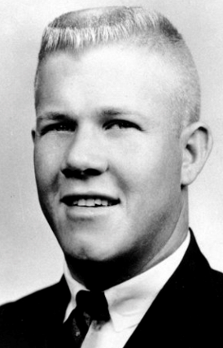
Thought Experiment

Slide 8
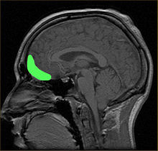
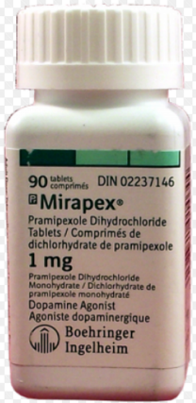
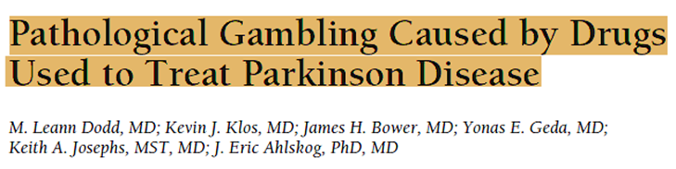
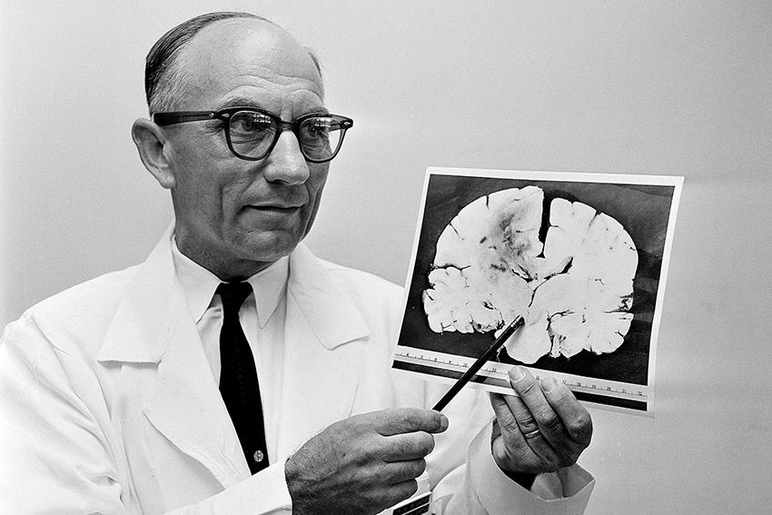
The Answers

Slide 9
Were these unique exceptions?
Or are all of us susceptible to this phenomenon?

Slide 10
I E D
Frontotemporal Dementia

Slide 11
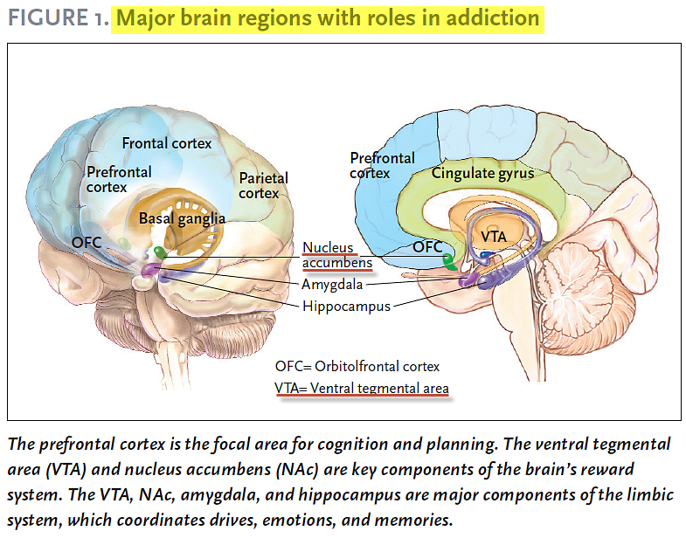
SCIENCE & PRACTICE PERSPECTIVES — APRIL 2007

Slide 12
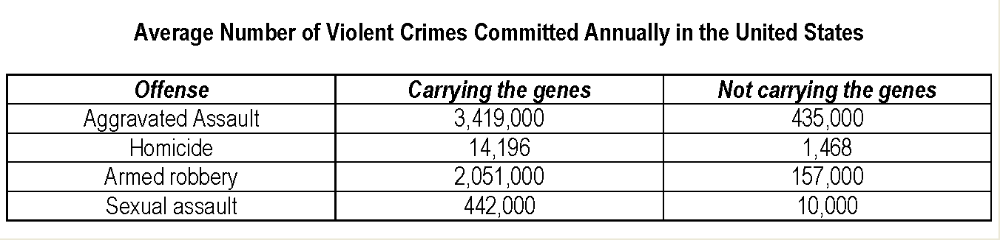
Genes = Y chromosome
Incognito: The Secret Lives of the Brain by David Eagleman. 2011. Pantheon

Slide 13
The heart is deceitful above all things, and desperately wicked: who can know it? (Jer 17:9)

Slide 14
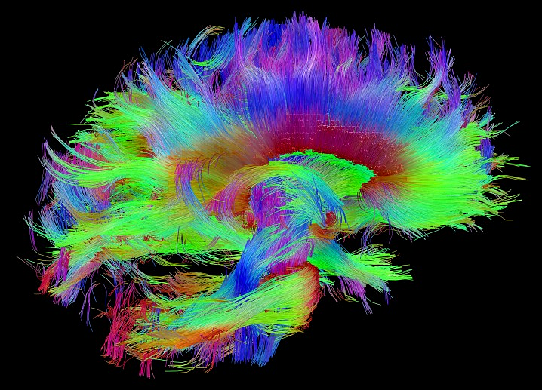
http://www.humanconnectomeproject.org/gallery/

Slide 15
GENETICS = MORALITY?

Slide 16
I call heaven and earth to record this day against you, that I have set before you life and death, blessing and cursing: therefore choose life, that both thou and thy seed may live: (Deu 30:19)

Slide 17
For the good that I will to do, I do not do; but the evil I will not to do, that I practice. Now if I do what I will not to do, it is no longer I who do it, but sin that dwells in me. I find then a law, that evil is present with me, the one who wills to do good. For I delight in the law of God according to the inward man. But I see another law in my members, warring against the law of my mind, and bringing me into captivity to the law of sin which is in my members. O wretched man that I am! Who will deliver me from this body of death? (Romans 7:19-24 NKJV)

Slide 18
So get rid of your old self, which made you live as you used to—the old self that was being destroyed by its deceitful desires. Your hearts and minds must be made completely new, and you must put on the new self, which is created in God's likeness and reveals itself in the true life that is upright and holy. (Eph 4:22-24 GNB)

Slide 19
Jesus answered and said unto him, Verily, verily, I say unto thee, Except a man be born again, he cannot see the kingdom of God. (John 3:3)

Slide 20
SIN IS HEREDITARY
(Romans 5:12 KJV) Wherefore, as by one man sin entered into the world, and death by sin; and so death passed upon all men, for that all have sinned:
(Romans 5:14 KJV) Nevertheless death reigned from Adam to Moses, even over them that had not sinned after the similitude of Adam's transgression, who is the figure of him that was to come.

Slide 21
Can the Ethiopian change his skin, or the leopard his spots? then may ye also do good, that are accustomed to do evil.
(Jer 13:23)

Slide 22
IS “FORGIVENESS” THE ANSWER TO THE SIN PROBLEM?

Slide 23
The Savior made no murmur of complaint. His face remained calm and serene, but great drops of sweat stood upon His brow. . . . While the soldiers were doing their fearful work, Jesus prayed for His enemies, “Father, forgive them; for they know not what they do.” {CSA 37.4}
That prayer of Christ for His enemies embraced the world. It took in every sinner that had lived or should live, from the beginning of the world to the end of time. Upon all rests the guilt of crucifying the Son of God. To all, forgiveness is freely offered. "Whosoever will" may have peace with God, and inherit eternal life. {DA 745.1}

Slide 24
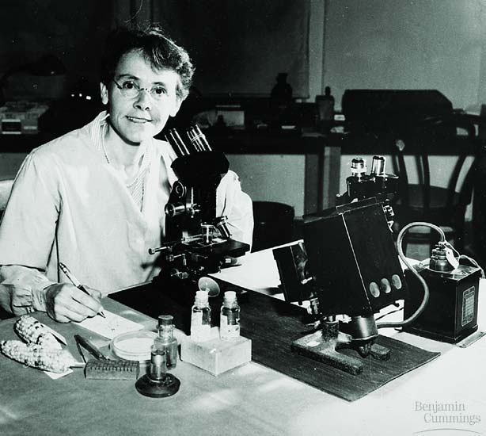
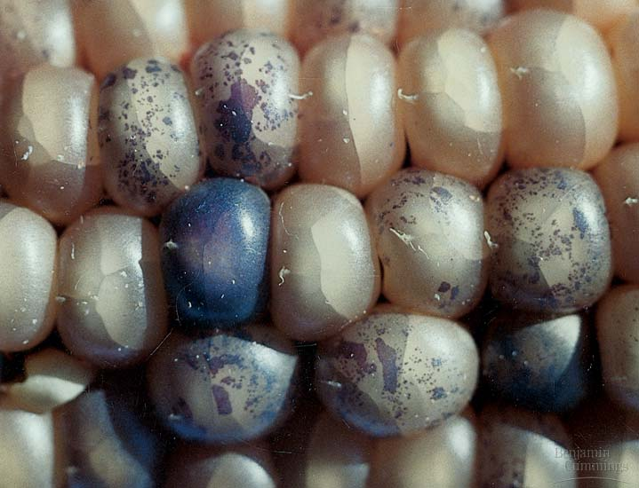
Barbara McClintock discovered that segments of DNA called transposons can move about within a cell’s genome
Figure 12.13B, C

Slide 25
We now know that transposons constitute more than 65% of our genomes and approximately 85% of the maize genome. “Transposons are astonishingly abundant, comprising a majority of the DNA in some species,” said Nina Fedoroff, a professor at Penn State University.
PNAS | December 11, 2012 | vol. 109 | no. 50

Slide 26
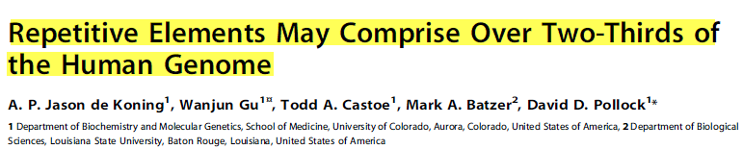
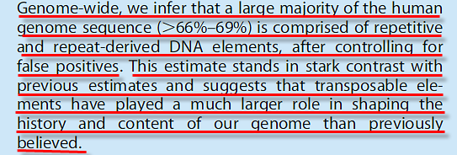
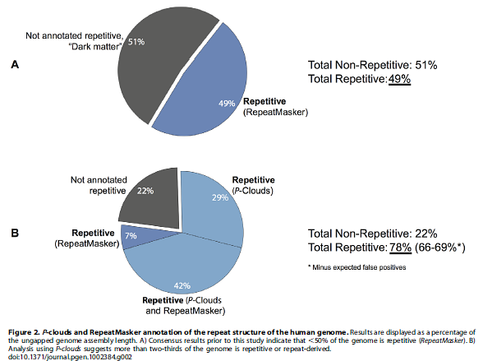
PLoS Genetics | 1 December 2011 | Volume 7 | Issue 12

Slide 27
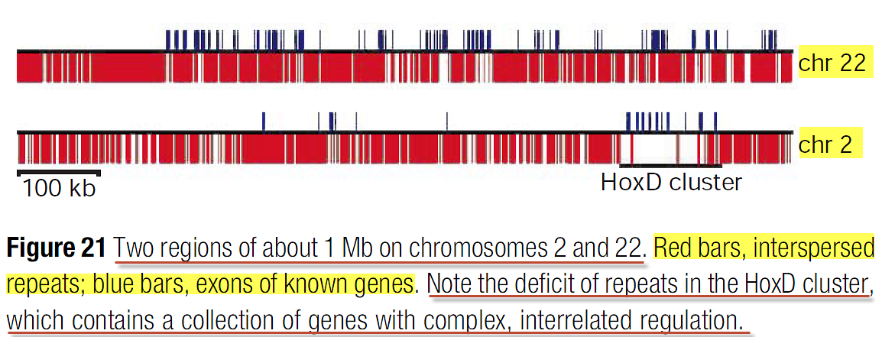
NATURE .VOL 409 .15 FEBRUARY 2001

Slide 28
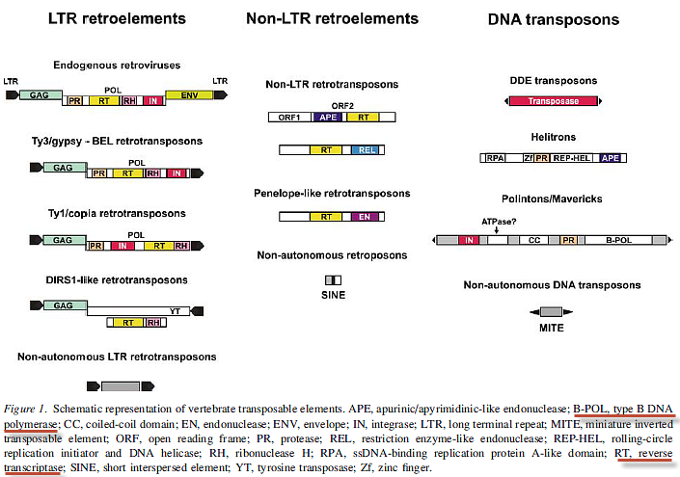
Chromosome Research (2008) 16:203-215

Slide 29
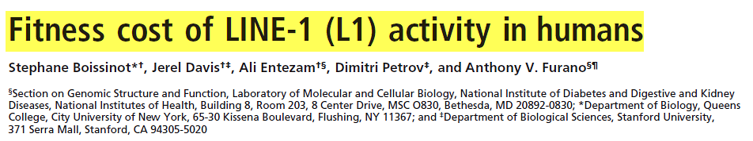
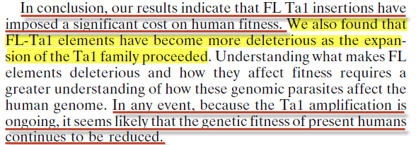
PNAS June 20, 2006 vol. 103 no. 25 9591

Slide 30
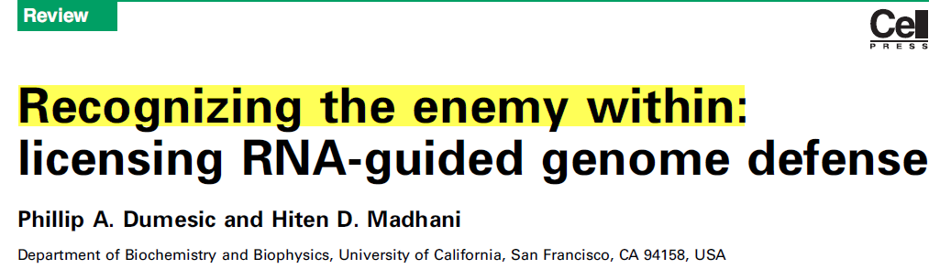
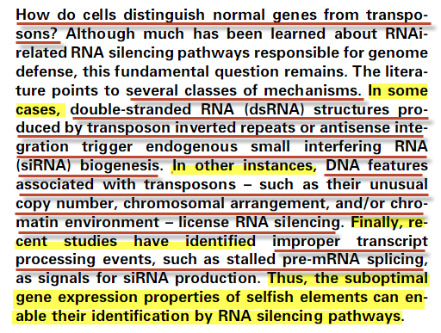
Trends in Biochemical Sciences, January 2014, Vol. 39, No. 1

Slide 31
WHERE DID MGE’S COME FROM?
SCIENCE HAS NO ANSWERS.

Slide 32
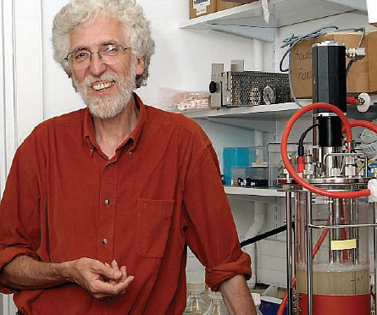
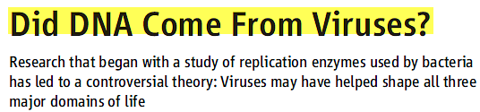

Scientists who deal in the history of life have never been quite sure what to do with viruses. One measure of their uncertainty is the Tree of Life Web Project, a collective effort to record everything known about the relationships of living and extinct species. (www.tolweb.org)
Scientists continued to find more DNA-copying enzymes in viruses that have no counterparts in the world of cells, and Forterre’s suspicions deepened.
12 MAY 2006 VOL 312 SCIENCE

Slide 33
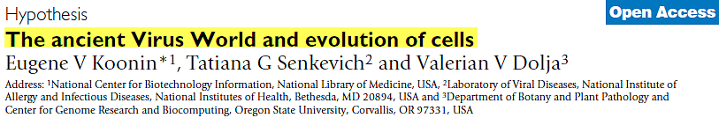
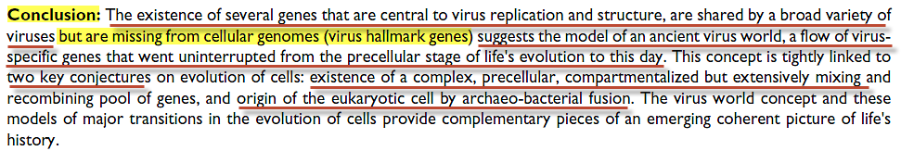

Biology Direct 2006, 1:29

Slide 34
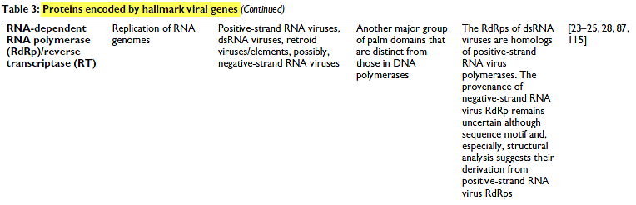
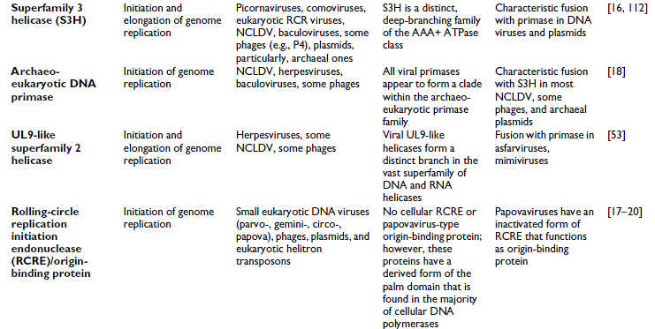
Biology Direct 2006, 1:29

Slide 35
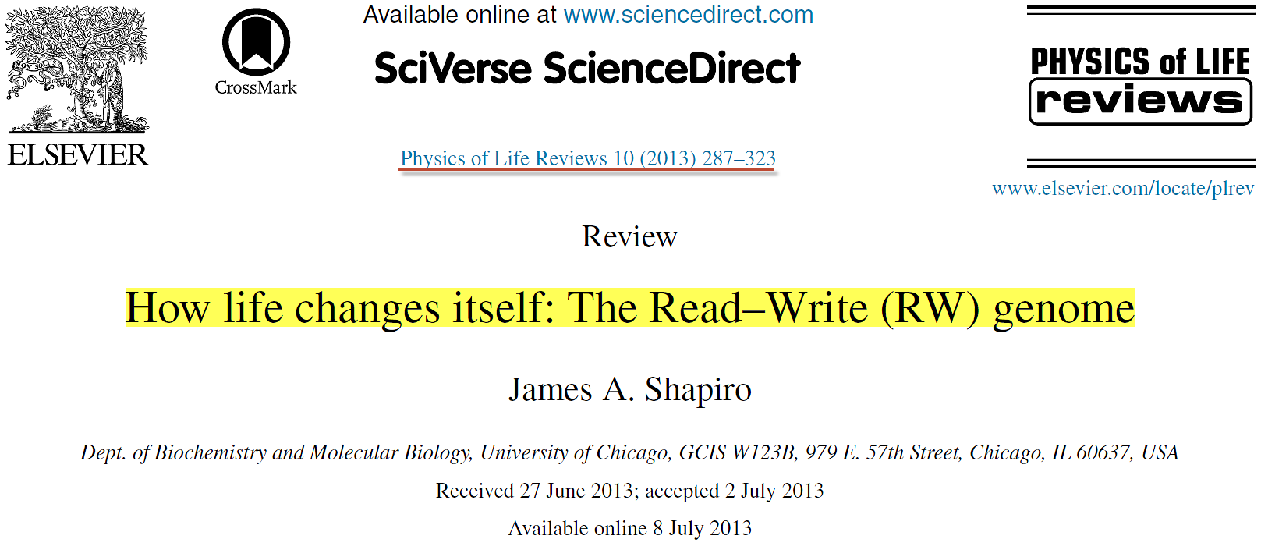
Instead of Read Only
Physics of Life Reviews- 10 (2013) 287–323

Slide 36
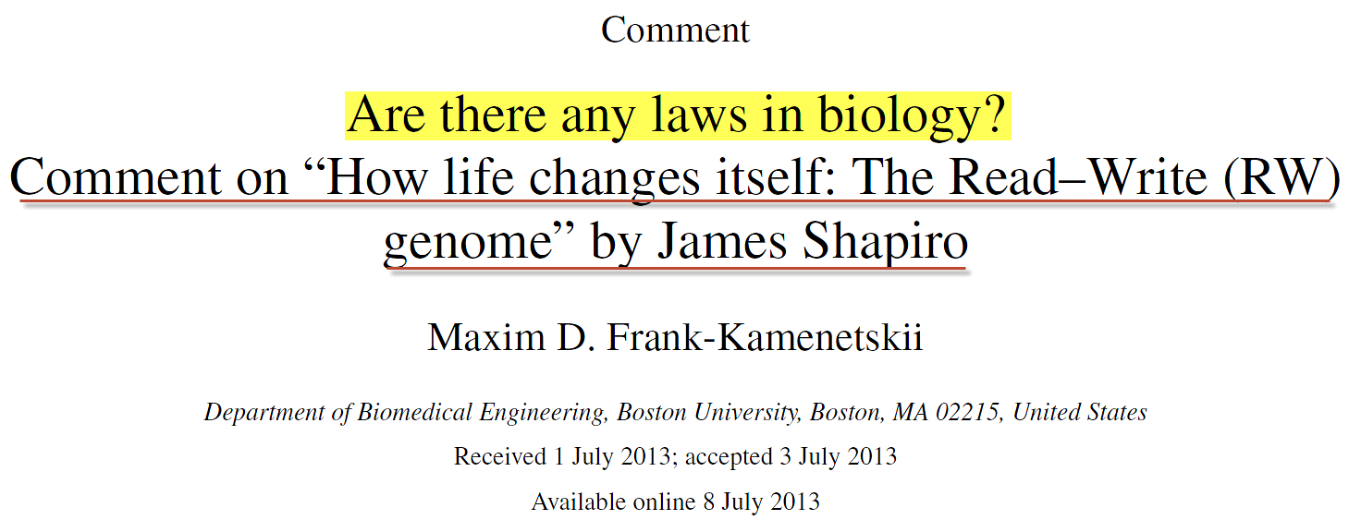
Being educated as a physicist, I find the most frustrating aspect of biology in the lack of universal laws.
Of course, we understand why biology is so lawless. Because what we currently observe and study on this planet is the result of 3.5 billion years of evolution with its stochastic trial and error approach.
Yes,biology IS muddy.
Physics of Life Reviews.10 (2013) 328–330

Slide 37
Whoever commits sin also commits lawlessness, and sin is lawlessness. (1Jn 3:4)

Slide 38
But whoso looketh into the perfect law of liberty, and continueth therein, he being not a forgetful hearer, but a doer of the work, this man shall be blessed in his deed. (James 1:25 KJV)
But whoever looks intently into the perfect law that gives freedom, and continues in it--not forgetting what they have heard, but doing it--they will be blessed in what they do. (James 1:25 NIV)

Slide 39
For I say to you that this that has been written must yet be fulfilled in Me: "And He was numbered with the lawless." (Isa. 53:12) For the things concerning Me also have an end.
(Luke 22:37 LITV)

Slide 40
What is the result of TE’s on the genome?
Aging
Death
Cancer
Genetic Diseases
Autoimmune Diseases
Endocrine & Metabolic Diseases
Psychiatric Diseases
“Selfish” behavior

Slide 41

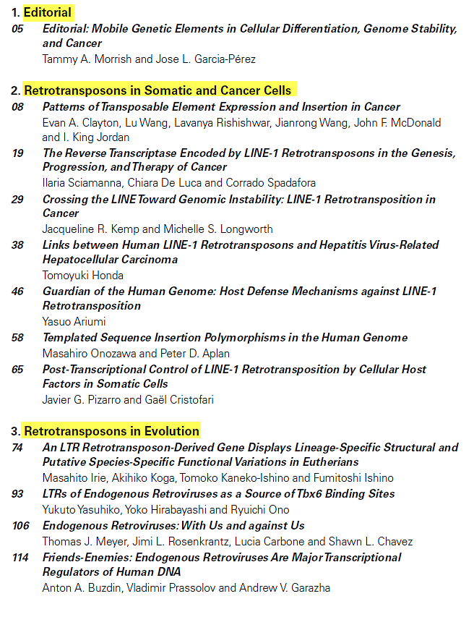
Table of Contents
January 2018 | Mobile Genetic Elements

Slide 42
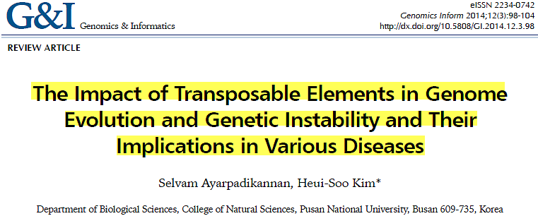
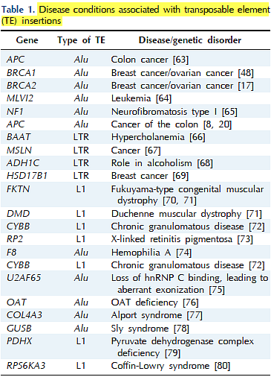
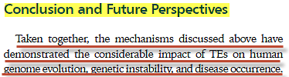

Slide 43
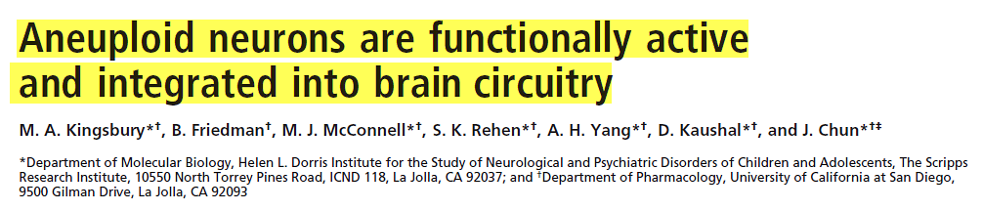
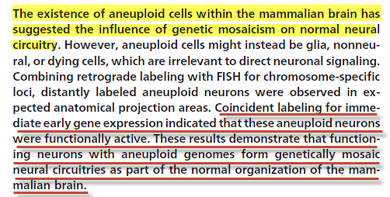
PNAS April 26, 2005 vol. 102 no. 17 6143–6147

Slide 44
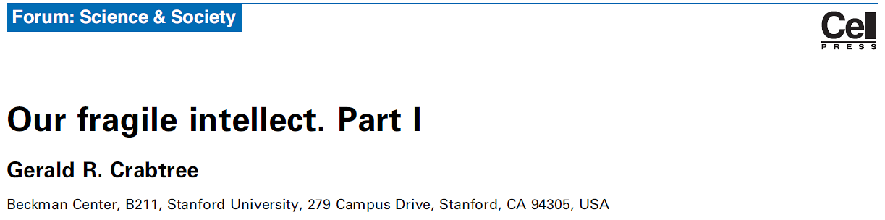
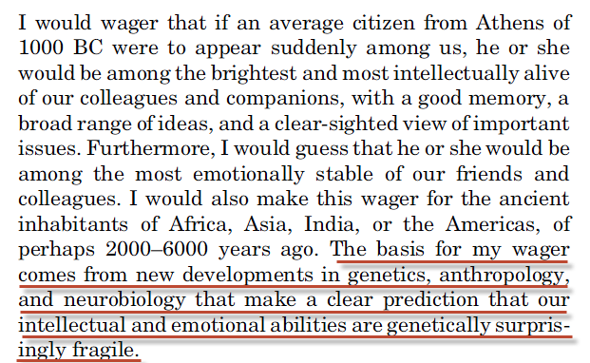
Trends in Genetics January 2013, Vol. 29, No. 1

Slide 45
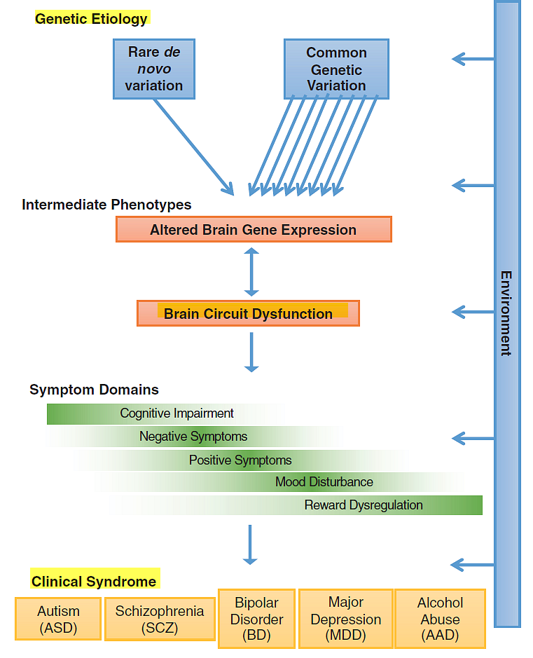

Science 359, 693–697 (2018) 9 February 2018

Slide 46
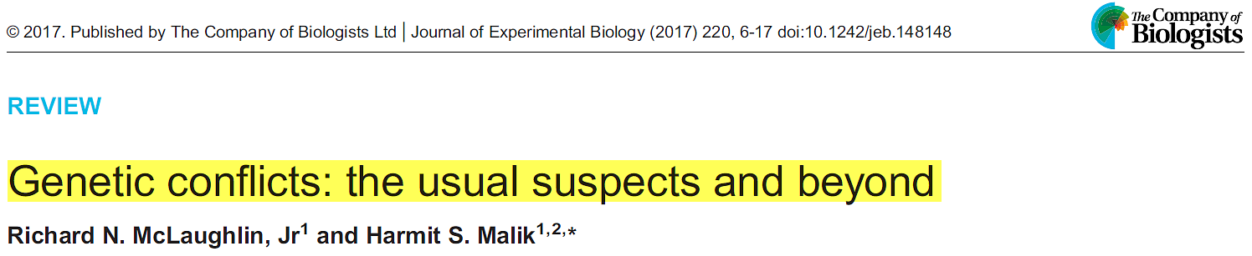
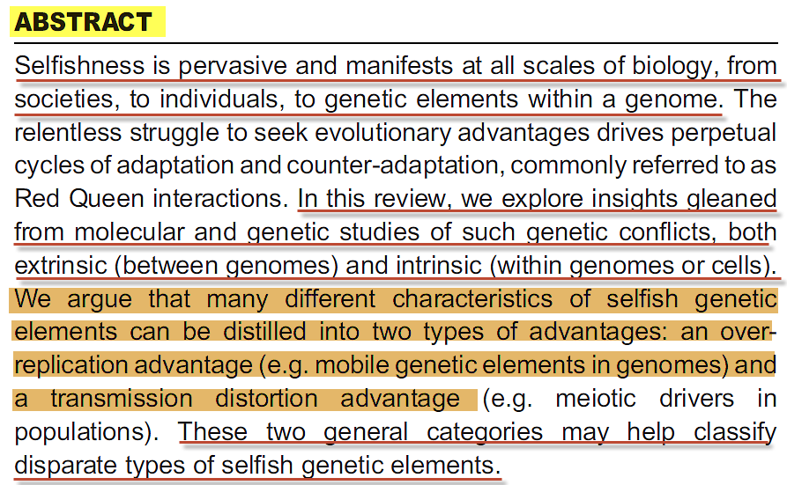
Journal of Experimental Biology (2017) 220, 6-17

Slide 47
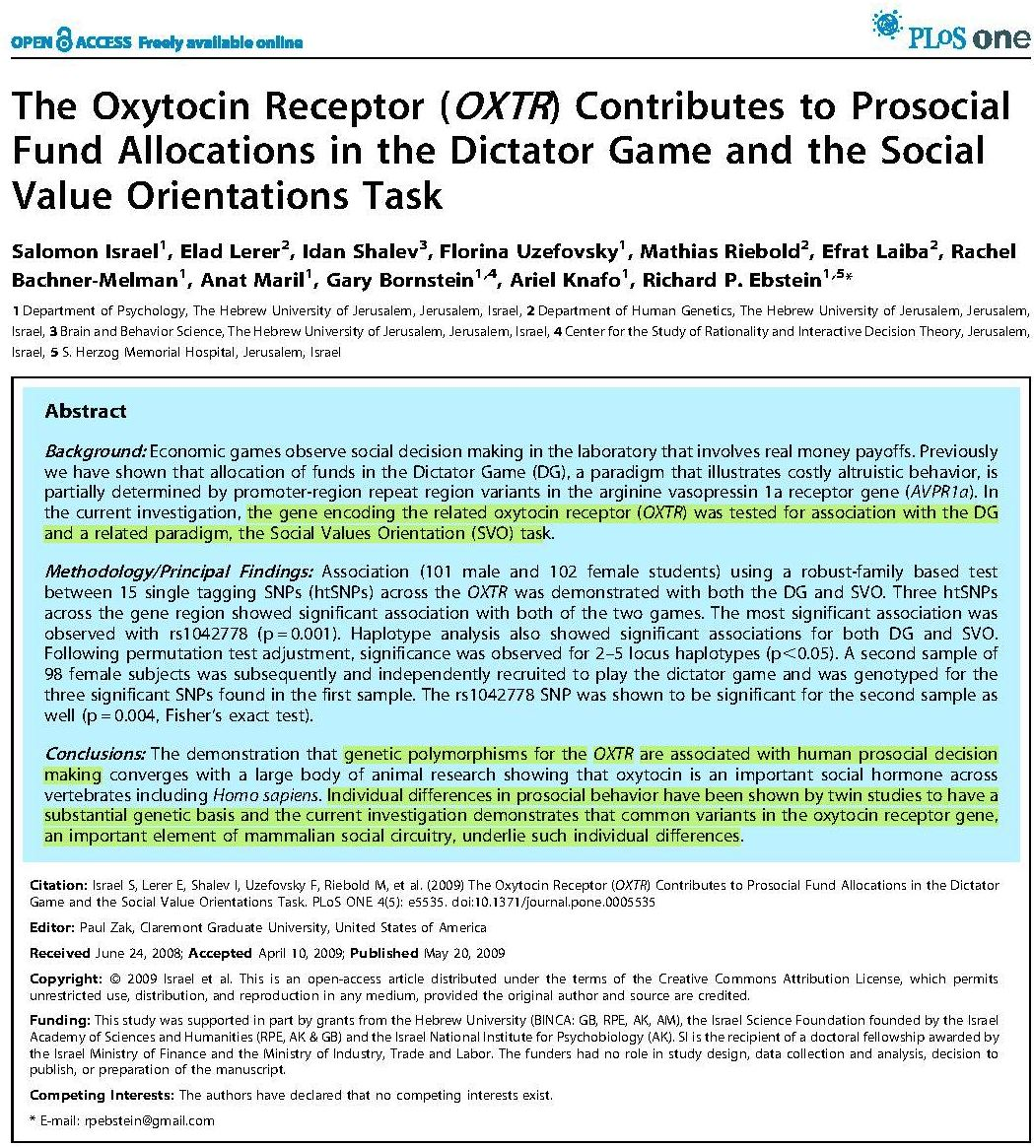
Transposable Elements Affect Human Behavior!

Slide 48
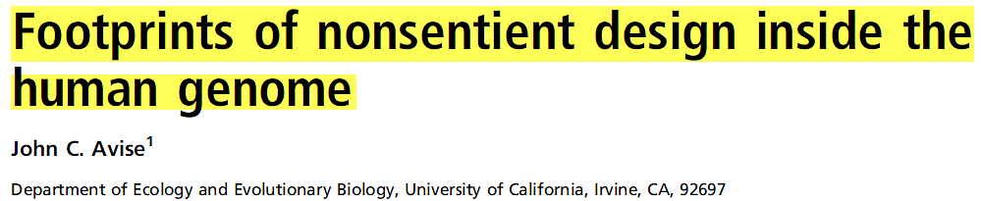
Evolution by natural causes in effect emancipates religion from the shackles of theodicy. No longer need we agonize about why a Creator God is the world’s leading abortionist and mass murderer. No longer need we query a Creator God’s motives for debilitating countless innocents with horrific genetic conditions. No longer must we anguish about the interventionist motives of a supreme intelligence that permits gross evil and suffering in the world.
PNAS | May 11, 2010 | vol. 107 | suppl. 2

Slide 49
And God saw every thing that he had made, and, behold, it was very good. (Gen 1:31)
So What happened?

Slide 50
The Biblical Description:
And when the woman saw that the tree was good for food, and that it was pleasant to the eyes, and a tree to be desired to make one wise, she took of the fruit thereof, and did eat, and gave also unto her husband with her; and he did eat. And the eyes of them both were opened, and they knew that they were naked; and they sewed fig leaves together, and made themselves aprons. (Gen 3:6-7)
This was not a “punishment”!

Slide 51
God responds:
And I will put enmity between thee and the woman, and between thy seed and her seed; it shall bruise thy head, and thou shalt bruise his heel.
(Gen 3:15)
You and this woman will hate each other; your descendants and hers will always be enemies. One of hers will strike you on the head, and you will strike him on the heel. (Gen 3:15)

Slide 52
G4690 - Strong’s Number - Greek
sperma H319 acharit - after part, end
sperma H1121 ben - son, grandson, child
sperma H1320 basar - flesh
sperma H2233 zera - seed, sowing, semen virile
sperma H5209 nin - offspring, posterity
sperma H5220 nekhed - progeny, posterity

Slide 53
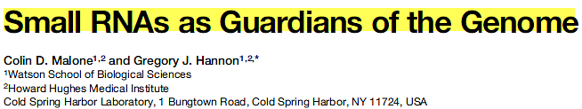
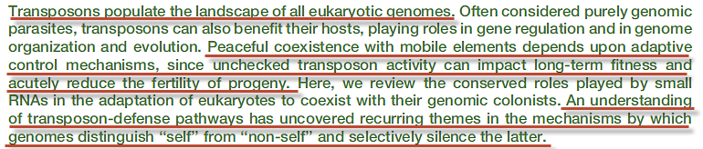
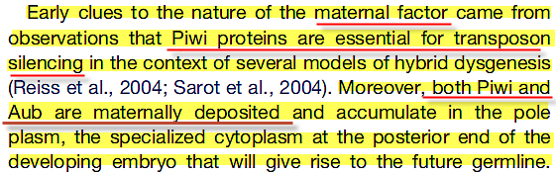
Cell 136, 656–668, February 20, 2009

Slide 54
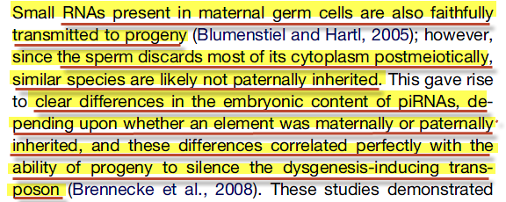
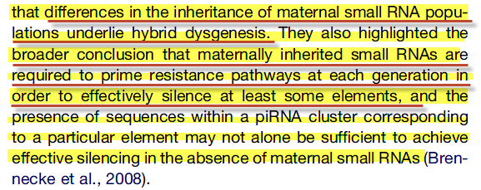
Small RNAs as Guardians of the Genome:
Cell 136, 656–668, February 20, 2009

Slide 55
'ârar
BDB Definition:
1) to curse
Theological Wordbook of The Old Testament:
Hebrew 'arar means "to bind (with a spell), hem in with obstacles, render powerless to resist."

Slide 56
The snake is “cursed”:
And the LORD God said unto the serpent, Because thou hast done this, thou art cursed above all cattle, and above every beast of the field; upon thy belly shalt thou go, and dust shalt thou eat all the days of thy life:
(Gen 3:14)

Slide 57
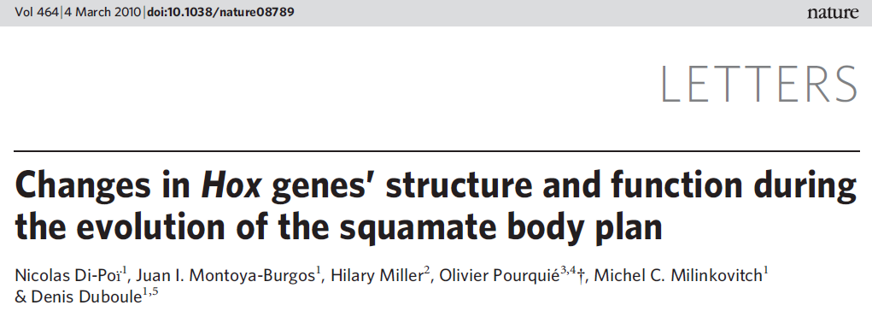
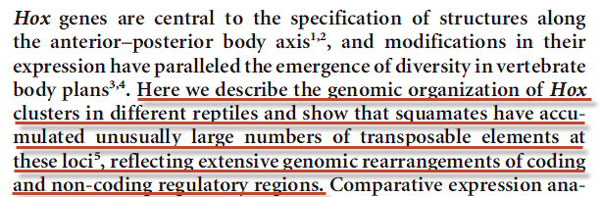
NATURE| Vol 464|4 March 2010

Slide 58
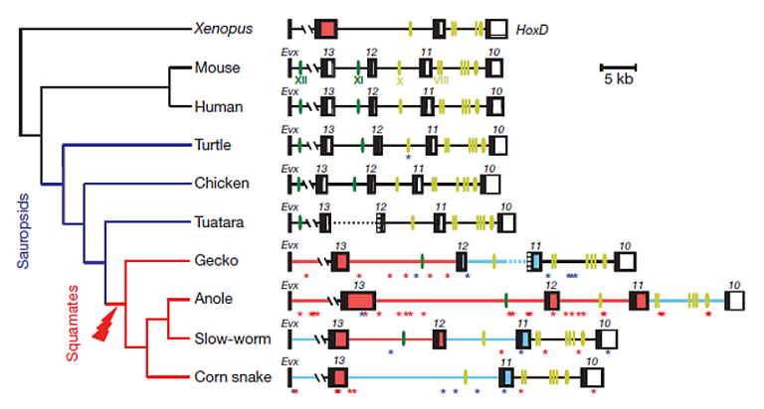
Transposable elements are indicated with asterisks of different colors (blue for DNA transposons; red for retrotransposons).
NATURE| Vol 464|4 March 2010

Slide 59
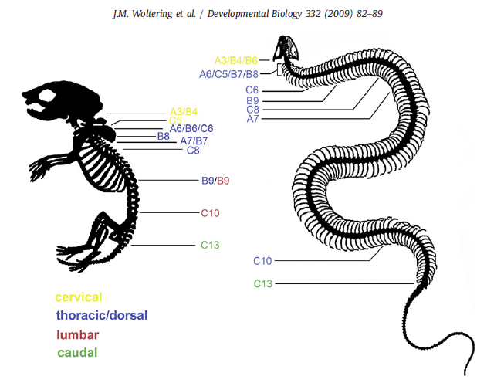

Slide 60
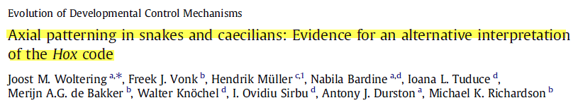

No limb buds are present in corn snakes however, and neither is any molecular trace of a discrete forelimb domain.
Developmental Biology 332 (2009) 82–89

Slide 61



the Tbx5 gene, deeply embedded in the vertebrate heart formation GRN, turns out to be regulated differently during heart formation in reptiles than in birds and mammals,…(p 976)
Cell 144, March 18, 2011

Slide 62
Eve is “cursed”:
Unto the woman he said, I will greatly multiply thy sorrow and thy conception; in sorrow thou shalt bring forth children; and thy desire shall be to thy husband, and he shall rule over thee.
(Gen 3:16 KJV)
And he said to the woman, "I will increase your trouble in pregnancy and your pain in giving birth. In spite of this, you will still have desire for your husband, yet you will be subject to him."
(Gen 3:16 GNB)

Slide 63


Nature Genetics 25 September 2011

Slide 64


Two LTR Retrotransposon-derived Genes, PEG10 and PEG11/RTL1, Play an Essential Role in Mammalian Development

Slide 65
Review: Human Endogenous Retroviruses and the Placenta
Jun Sugimoto, PhD University of Missouri-Columbia, Department of Obstetrics, Gynecology and Women's Health, Division of Reproductive Endocrinology and Infertility, Columbia, Missouri, Danny J. Schust, MD
University of Missouri-Columbia, Department of Obstetrics, Gynecology and Women's Health, Division of Reproductive Endocrinology and Infertility, Columbia, Missouri
Up to 8% of the human genome is of retroviral origin. These stably integrated retroviral sequences that characterize the human endogenous retrovirus (HERV) arose from retroviral infections that occurred more than 25 million years ago. The host and the retrovirus have subsequently coevolved as retrovirally derived genetic material is propagated in a Mendelian fashion. Although most HERV sequences are silenced, several have been described that are functional. The effects of some HERV-derived products are linked to human disease; others appear essential to human organ function. The human placenta, unique in its active expression of retroviral sequences that are not expressed in other tissues, may hold the key to an improved understanding of the functional significance of HERVs. In this review, we discuss the contribution of retroelements, particularly HERVs, to placental function and dysfunction. We describe fusogenic and immunosuppressive HERV activities and emphasize epigenetic regulation of retroelement expression.
Key Words: Human endogenous retrovirus • placenta • immunosuppression • fusion • transposon.
This version was published on November 1, 2009

Slide 66
Behold, I was shapen in iniquity; and in sin did my mother conceive me.
(Psalms 51:5 KJV)

Slide 67
Adam is “cursed”:
And he said to the man, "You listened to your wife and ate the fruit which I told you not to eat. Because of what you have done, the ground will be under a curse. You will have to work hard all your life to make it produce enough food for you. It will produce weeds and thorns, and you will have to eat wild plants. You will have to work hard and sweat to make the soil produce anything, until you go back to the soil from which you were formed. You were made from soil, and you will become soil again."
(Gen 3:17-19)

Slide 68



Slide 69

Annals of Botany 109: 19–45, 2012

Slide 70



Aging Cell - 2013 Blackwell Publishing Ltd

Slide 71
Why should ye be stricken any more? ye will revolt more and more: the whole head is sick, and the whole heart faint. From the sole of the foot even unto the head there is no soundness in it; but wounds, and bruises, and putrifying sores: they have not been closed, neither bound up, neither mollified with ointment. (Isa 1:5-6)
They are all gone aside, they are all together become filthy: there is none that doeth good, no, not one. (Psa 14:3)
In meekness instructing those that oppose themselves; if God peradventure will give them repentance to the acknowledging of the truth; And that they may recover themselves out of the snare of the devil, who are taken captive by him at his will. (2Ti 2:25-26)

Slide 72


Slide 73
"Those who see you will gaze at you, And consider you, saying: 'Is this the man who made the earth tremble, Who shook kingdoms, Who made the world as a wilderness And destroyed its cities, Who did not open the house of his prisoners?‘ (Isa 14:16-17)
To open the blind eyes, to bring out the prisoners from the prison, and them that sit in darkness out of the prison house. (Isa 42:7)

Slide 74
Mat 13:24 Another parable put he forth to them, saying, The kingdom of heaven is likened to a man which sowed good seed in his field:
Mat 13:25 But while men slept, his enemy came and sowed tares among the wheat, and went his way.
Mat 13:26 But when the blade was sprung up, and brought forth fruit, then
appeared the tares also.
Mat 13:27 So the servants of the householder came and said to him, Sir, did
not you sow good seed in your field? from where then has it tares?
Mat 13:28 He said to them, An enemy has done this. AKJV

Slide 75
How art thou fallen from heaven, O Lucifer, son of the morning! how art thou cut down to the ground, which didst weaken the nations! For thou hast said in thine heart, I will ascend into heaven, I will exalt my throne above the stars of God: I will sit also upon the mount of the congregation, in the sides of the north: I will ascend above the heights of the clouds; I will be like the most High. (Isa 14:12-14)

Slide 80

NATURE| Vol 464|4 March 2010

Slide 81

NATURE| Vol 464|4 March 2010

Slide 82
The operational "information" that He has placed in all of His created entities.
God's Law:
Sin:
Any unauthorized change to God's "information“ systems.

Slide 83
Gotta Serve Somebody
You may be an ambassador to England or France
You may like to gamble, you might like to dance
You may be the heavyweight champion of the world
You may be a socialite with a long string of pearls.
But you're gonna have to serve somebody, yes
Indeed you're gonna have to serve somebody.
Well, it may be the devil or it may be the Lord
But you're gonna have to serve somebody.
Bob Dylan

Slide 84
Then the LORD said to Cain, "Why are you angry? Why that scowl on your face? If you had done the right thing, you would be smiling; but because you have done evil, sin is crouching at your door. It wants to rule you, but you must overcome it."
(Genesis 4:6-7 GNB)

Slide 85
Ye are of your father the devil, and the lusts of your father ye will do. He was a murderer from the beginning, and abode not in the truth, because there is no truth in him. When he speaketh a lie, he speaketh of his own: for he is a liar, and the father of it.
(John 8:44 KJV)

